Slide 1
West Barn, Lewis & Clark County Fairgrounds HABs Photos
Presented by Pam Attardo
Historic Preservation Officer

Slide 2
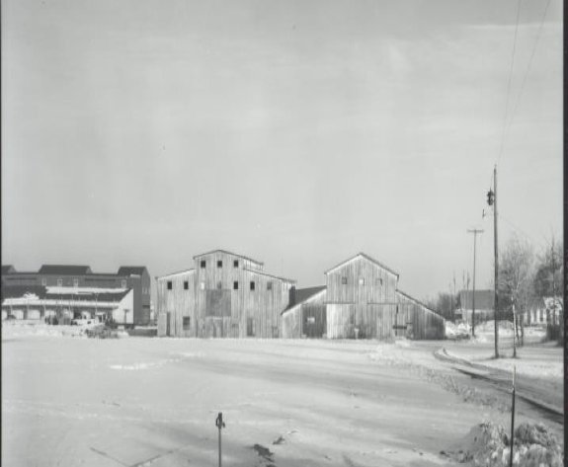
West Barn: built by the State of Montana ca. 1929
Documented December 2010 prior to demolition
Rear, North Barn on left, West Barn on Right;
View to Northeast

Slide 3
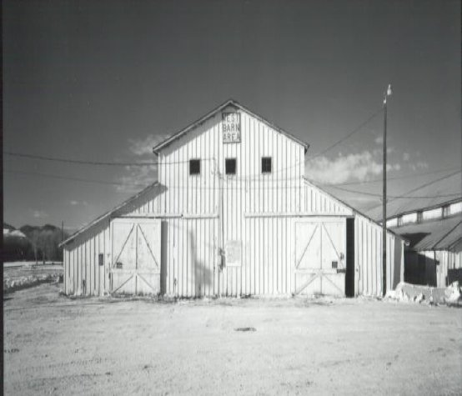
East Elevation of South Section of West Barn, looking West

Slide 4
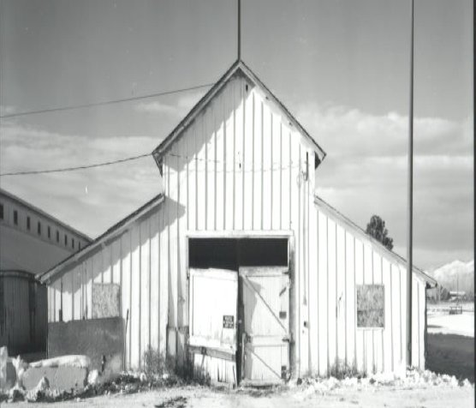
North Barn, front (East elevation of North section,
looking West)

Slide 5
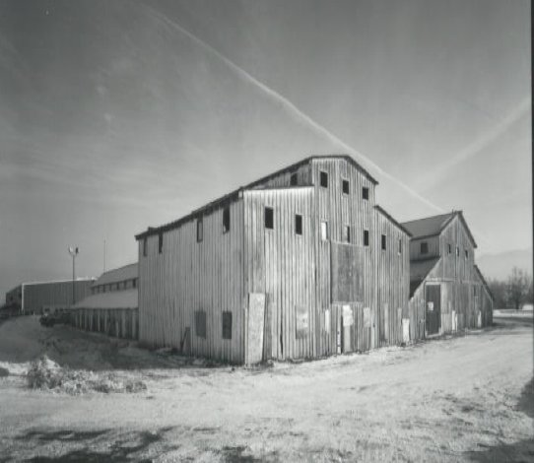
North and West Barns, rear, Oblique, Southeast corner, looking Northwest

Slide 6
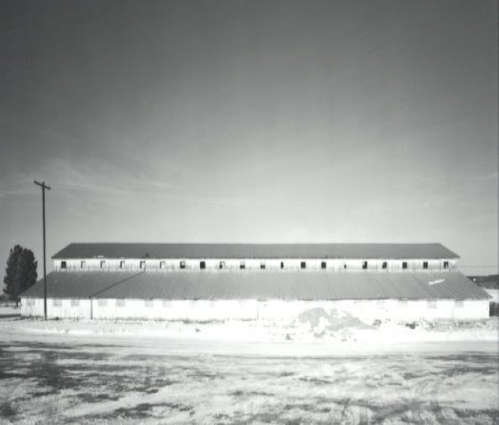
West Barn, South elevation, looking North

Slide 7
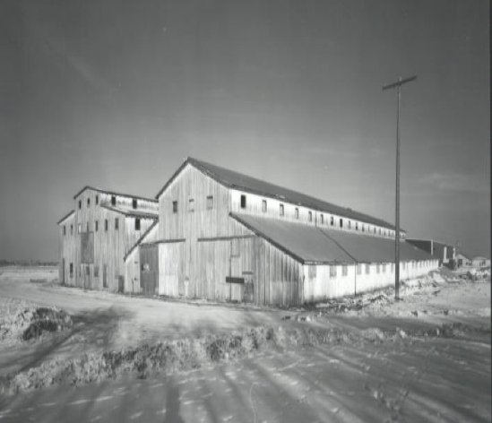
North and West Barn rear, oblique, Southwest Corner, looking Northeast

Slide 8
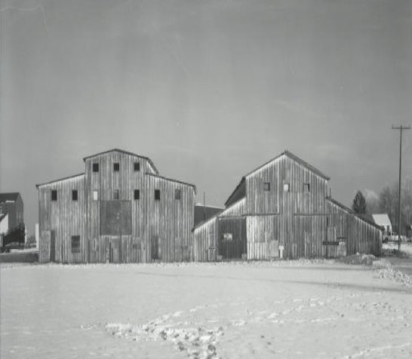
North and West Barn rear, West elevation, looking East

Slide 9
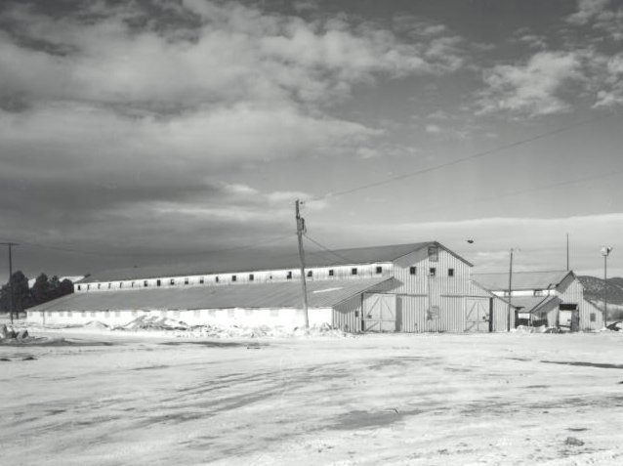
West and North Barn, oblique, Northwest Corner, looking Southeast

Slide 10
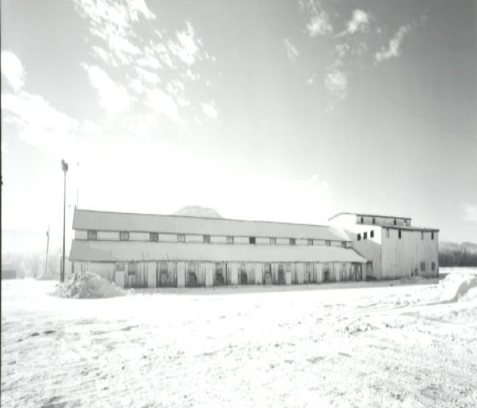
North Barn, North elevation, looking South

Slide 11
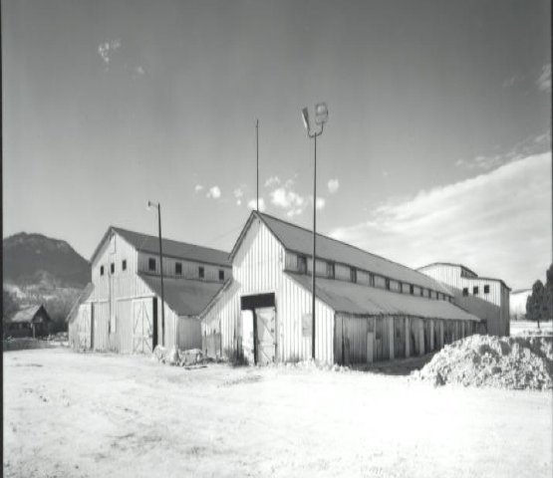
West and North Barn, oblique, Northeast Corner, looking Southwest

Slide 12
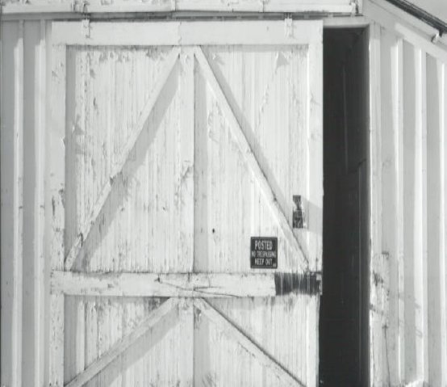
West Barn detail, door on South Section (front),
East elevation

Slide 13
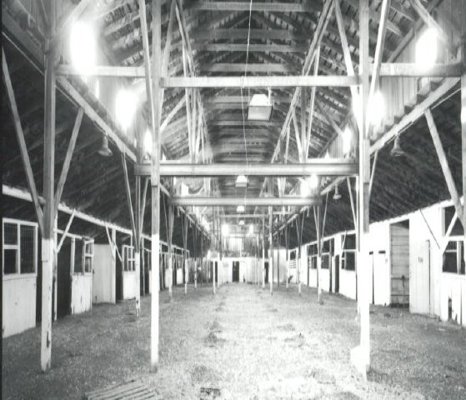
West Barn, interior of South section, looking West

Slide 14
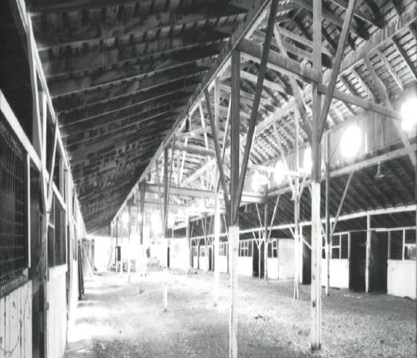
West Barn, interior of South Section, looking Southeast

Slide 15
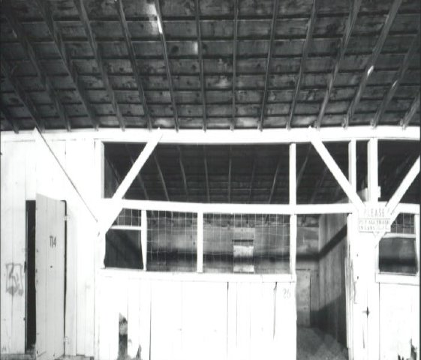
West Barn, interior of North section, detail of typical stall, looking South

Slide 16
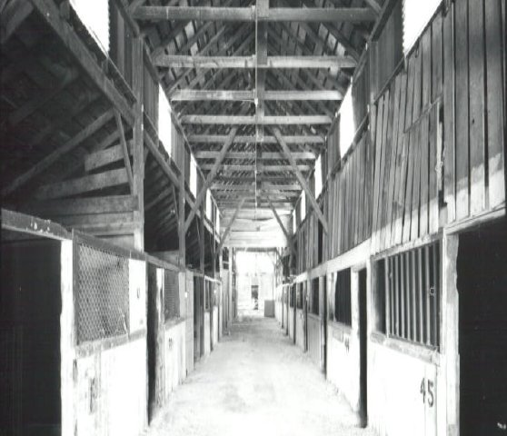
West Barn, interior of North section, looking West

Slide 17
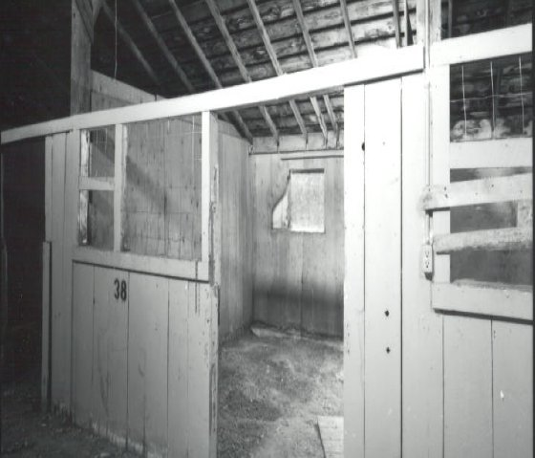
West Barn, interior of North section, detail of typical stall, looking Northwest

Slide 18
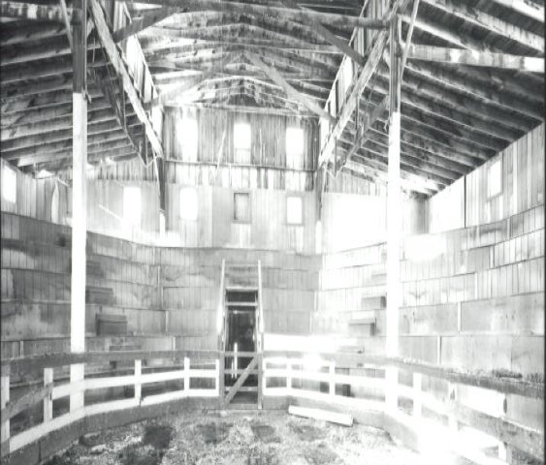
North Barn, interior, auction arena, looking West

Slide 19
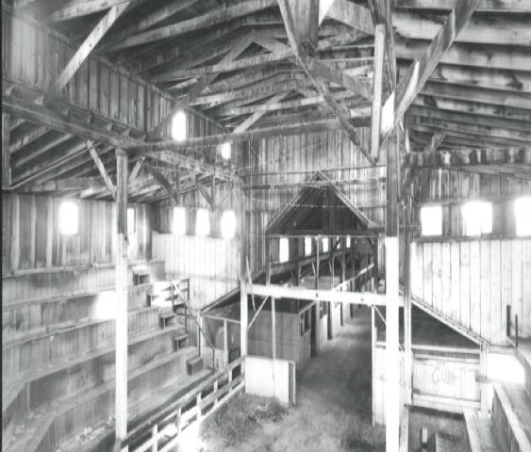
North Barn, interior of North section, auction arena, looking Northeast

